Slide 1
Unit 8: Sorting

Slide 2
CONTENTS
Introduction
Internal and External Sort
Insertion and Selection Sort
Exchange Sort
Bubble and Quick Sort
Merge and Radix Sort
Shell Sort
Binary Sort
Heap Sort as Priority Queue
Efficiency of Sorting
Big 'O‘ Notation.

Slide 3
Big O Notation
What is Big O Notation in Data Structure?
Big O Notation in Data Structure is used to express algorithmic complexity using algebraic terms. It describes the upper bound of an algorithm's runtime and calculates the time and amount of memory needed to execute the algorithm for an input value.

Slide 4
Big O Notation
Writing Big O Notation
When we write Big O notation, we look for the fastest-growing term as the input gets larger and larger. We can simplify the equation by dropping constants and any non-dominant terms.
For example, O(2N) becomes O(N), and O(N² + N + 1000) becomes O(N²).
Binary Search is O(log N) which is less complex than Linear Search. There are many more complex algorithms. A common example of a quadratic algorithm or O(N²) is a nested for loop. In a nested loop, we iterate through the entire data in an outer loop. Then for each element, we iterate through the data in an inner loop. This is N x N times of N².

Slide 5
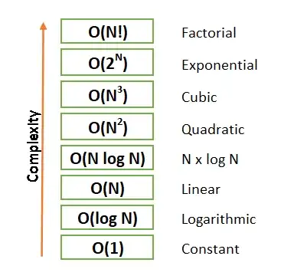

Slide 6
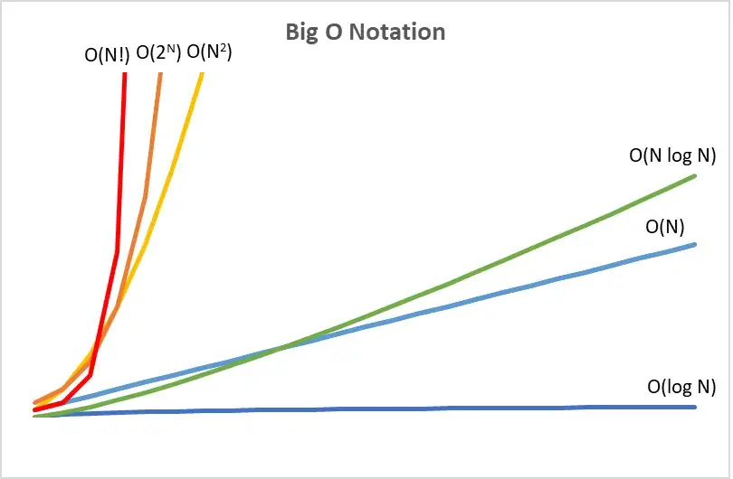

Slide 7
Sorting
Sorting is a technique to rearrange the elements of a list in ascending or descending order
Sorting is a process through which the data is arranged in ascending or descending order
The complexity of a sorting algorithm can be measured in terms of
number of algorithm steps to sort n records
number of comparisons between keys (appropriate when the keys are long character strings)
number of times records must be moved (appropriate when record size is large)
Example:
1, 3, 4, 6, 8, 9 are in increasing order, as every next element is greater than the previous element.
9, 8, 6, 4, 3, 1 are in decreasing order, as every next element is less than the previous element.
9, 8, 6, 3, 3, 1 are in non-increasing order, as every next element is less than or equal to (in case of 3) but not greater than any previous element.
1, 3, 3, 6, 8, 9 are in non-decreasing order, as every next element is greater than or equal to (in case of 3) but not less than the previous one.

Slide 8
Sorting …
Sorting algorithms may require some extra space for comparison and temporary storage of few data elements.
Those algorithms which do not require any extra space for sorting is said to happen in-place or within the array itself. It is called in-place sorting.
Bubble sort is an example of in-place sorting.
Sorting which uses equal or more space is called not-in-place sorting.
Merge-sort is an example of not-in-place sorting.

Slide 9
Internal vs External Sorting
Internal Sort
An internal sort is any data sorting process that takes place entirely within the main memory of a computer. This is possible whenever the data to be sorted is small enough to all be held in the main memory.
There are 3 types of internal sorts.
SELECTION SORT
INSERTION SORT
EXCHANGE SORT
External sort
Sorting large amount of data requires external or secondary memory. This process uses external memory such as HDD, to store the data which is not fit into the main memory therefore called external sort.
So, primary memory holds the currently being sorted data only. All external sorts are based on process of merging. Different parts of data are sorted separately and merged together. Ex:- Merge Sort

Slide 10
Types of Sorting
Insertion and Selection Sort
Exchange Sort
Bubble and Quick Sort
Merge and Radix Sort
Shell Sort
Binary Sort
Heap Sort as Priority Queue
Efficiency of Sorting
Big 'O‘ Notation.

Slide 11
Bubble Sort
Bubble Sort is the simplest sorting algorithm that works by repeatedly swapping the adjacent elements if they are in the wrong order. This algorithm is not suitable for small data sets as its average and worst-case time complexity is quite high for the big data set.
Algorithm
traverse from left and compare adjacent elements and the higher one is placed at right side.
In this way, the largest element is moved to the rightmost end at first.
This process is then continued to find the second largest and place it and so on until the data is sorted.

Slide 12
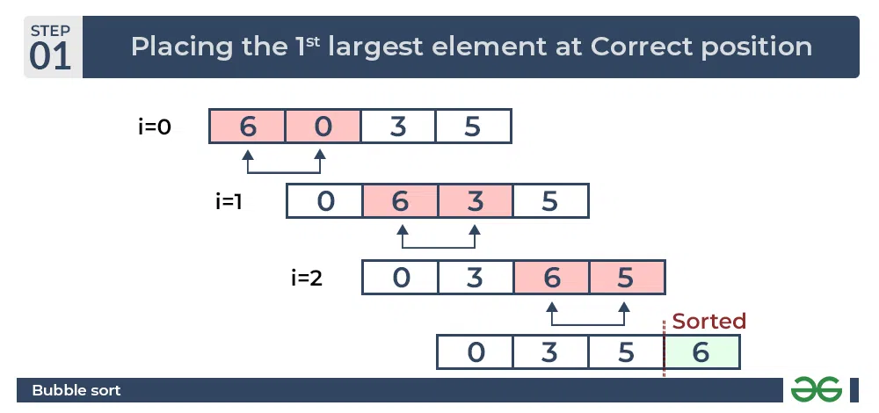
How Bubble Sort Works
Let us take an example of A= [6,0,3,5]
In the first Pass

Slide 13
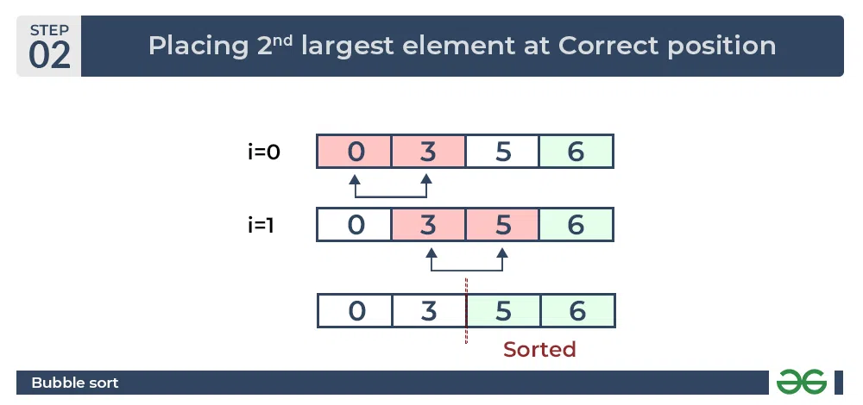
In the second pass

Slide 14
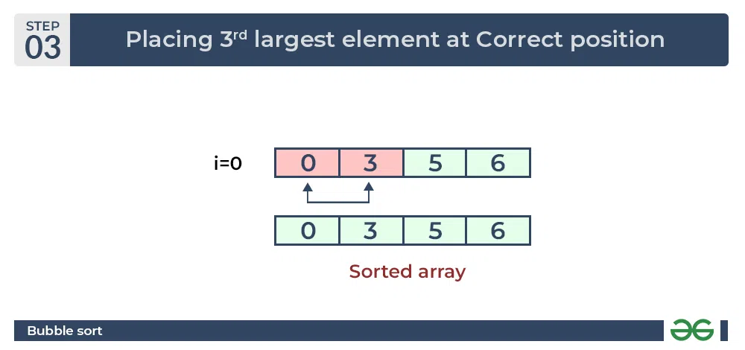
In the third pass

Slide 15
Insertion Sort
Insertion sort is a simple sorting algorithm that works similar to the way you sort playing cards in your hands.
The array is virtually split into a sorted and an unsorted part. Values from the unsorted part are picked and placed at the correct position in the sorted part.
Insertion Sort Algorithm
To sort an array of size N in ascending order iterate over the array and compare the current element (key) to its predecessor, if the key element is smaller than its predecessor, compare it to the elements before. Move the greater elements one position up to make space for the swapped element.

Slide 16
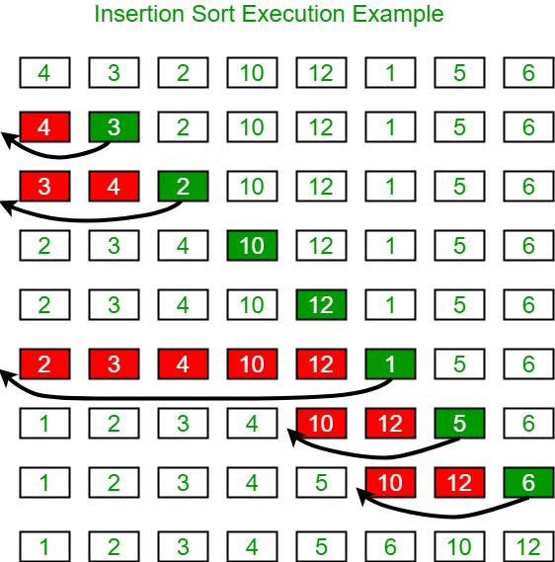
Working of Insertion sort
Consider an example:
arr[]: {4,3,2,10,12,1,5,6}

Slide 17
Selection Sort
Selection sort is a simple and efficient sorting algorithm that works by repeatedly selecting the smallest (or largest) element from the unsorted portion of the list and moving it to the sorted portion of the list.
Algorithm
Step 1 − Set MIN to location 0
Step 2 − Search the minimum element in the list
Step 3 − Swap with value at location MIN
Step 4 − Increment MIN to point to next element
Step 5 − Repeat until list is sorted

Slide 18

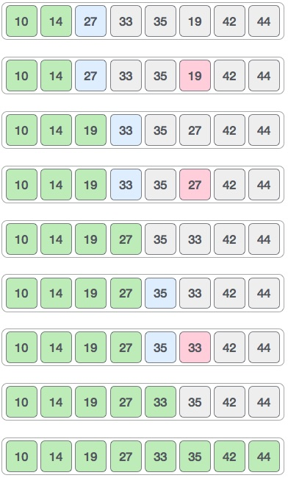





Selection Sort Example

Slide 19
Exchange sort
Exchange sort is an algorithm used to sort in ascending as well as descending order. It compares the first element with every element if any element seems out of order it swaps.
Input: arr[] = {5, 1, 4, 2, 8}
Output: {1, 2, 4, 5, 8}
Explanation: Working of exchange sort:
1st Pass:
Exchange sort starts with the very first elements, comparing with other elements to check which one is greater.
( 5 1 4 2 8 ) –> ( 1 5 4 2 8 ).
Here, the algorithm compares the first two elements and swaps since 5 > 1.
No swap since none of the elements is smaller than 1 so after 1st iteration (1 5 4 2 8)

Slide 20
Exchange sort
2nd Pass:
(1 5 4 2 8 ) –> ( 1 4 5 2 8 ), since 4 < 5
( 1 4 5 2 8 ) –> ( 1 2 5 4 8 ), since 2 < 4
( 1 2 5 4 8 ) No change since in this there is no other element smaller than 2
3rd Pass:
(1 2 5 4 8 ) -> (1 2 4 5 8 ), since 4 < 5
after completion of the iteration, we found array is sorted
After completing the iteration it will come out of the loop, Therefore array is sorted.

Slide 21
Quick Sort
Quick sort is a highly efficient sorting algorithm and is based on partitioning of array of data into smaller arrays. A large array is partitioned into two arrays one of which holds values smaller than the specified value, say pivot, based on which the partition is made and another array holds values greater than the pivot value.
Quicksort partitions an array and then calls itself recursively twice to sort the two resulting subarrays. This algorithm is quite efficient for large-sized data sets as its average and worst-case complexity are O(n²), respectively.

Slide 22
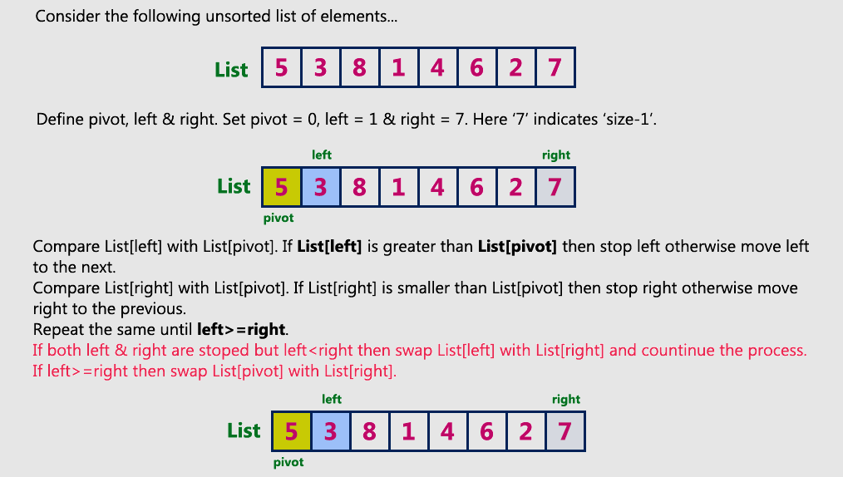
Working of the quick sort

Slide 23
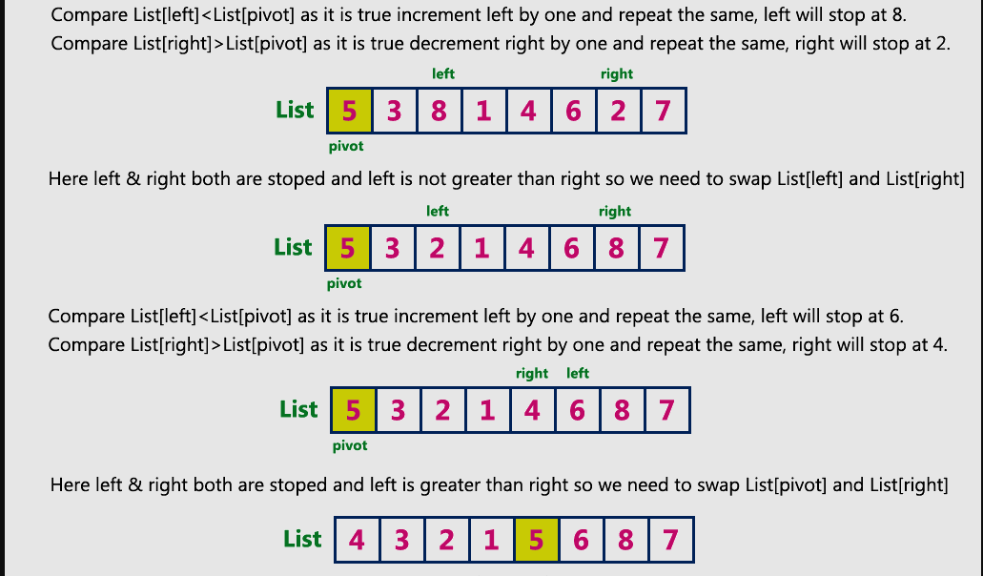
Working of the quick sort

Slide 24
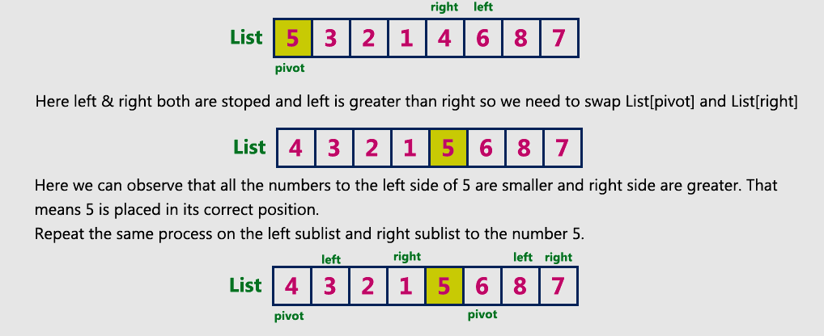
Working of the quick sort

Slide 25
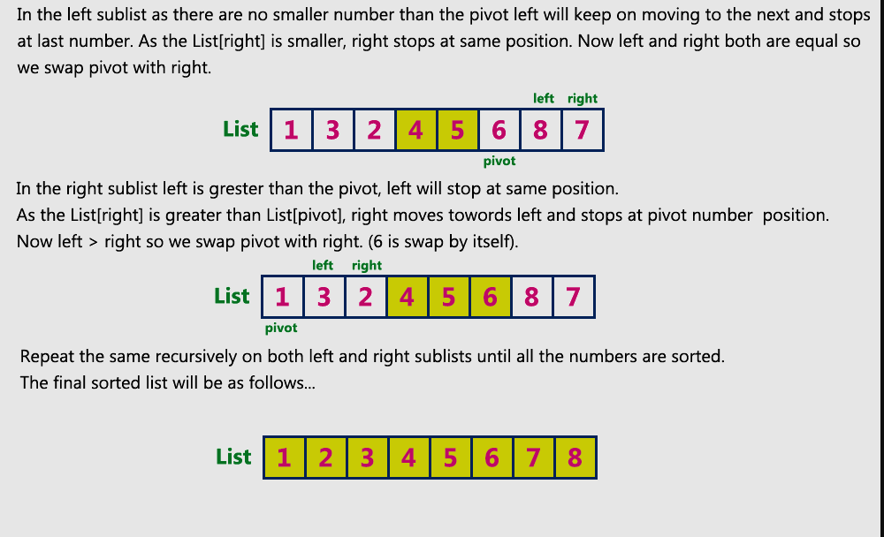
Working of the quick sort

Slide 26
Radix Sort
Radix sort is a sorting algorithm that sorts the elements by first grouping the individual digits of the same place value. Then, sort the elements according to their increasing/decreasing order.
Suppose, we have an array of 8 elements. First, we will sort elements based on the value of the unit place. Then, we will sort elements based on the value of the ten^{th} place. This process goes on until the last significant place.
Let the initial array be [121, 432, 564, 23, 1, 45, 788]. It is sorted according to radix sort as shown in the figure below.

Slide 27
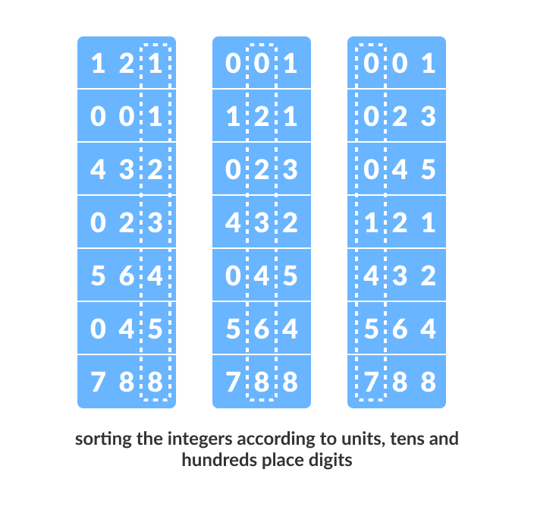
Radix Sort

Slide 28

Shell Sort
Shell sort is mainly a variation of insertion sort.
In insertion sort, we move elements only one position ahead. When an element has to be moved far ahead, many movements are involved.
The idea of Shell Sort is to allow the exchange of far items. In Shell sort, we make the array h-sorted for a large value of h. We keep reducing the value of h until it becomes 1. An array is said to be h-sorted if all subsists of every h’th element are sorted.
Let us consider an example

Slide 29
Shell Sort
We will use the original sequence of shell sort, i.e., N/2, N/4,....,1 as the intervals.
In the first loop, n is equal to 8 (size of the array), so the elements are lying at the interval of 4 (n/2 = 4). Elements will be compared and swapped if they are not in order.
Here, in the first loop, the element at the 0th position will be compared with the element at 4th position. If the 0th element is greater, it will be swapped with the element at 4th position. Otherwise, it remains the same. This process will continue for the remaining elements.
At the interval of 4, the sub lists are {33, 12}, {31, 17}, {40, 25}, {8, 42}.

Slide 30
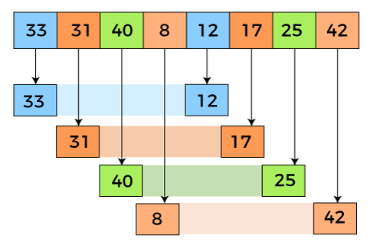
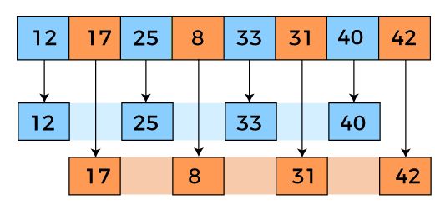


Shell Sort
N=4
N=2

Slide 31
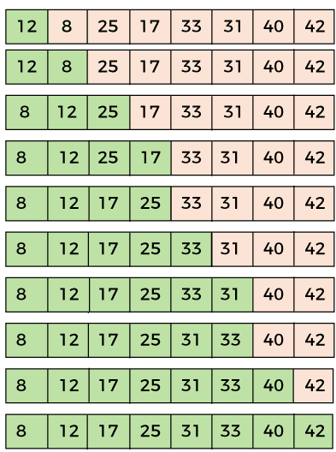
Shell Sort
N=1

Slide 32
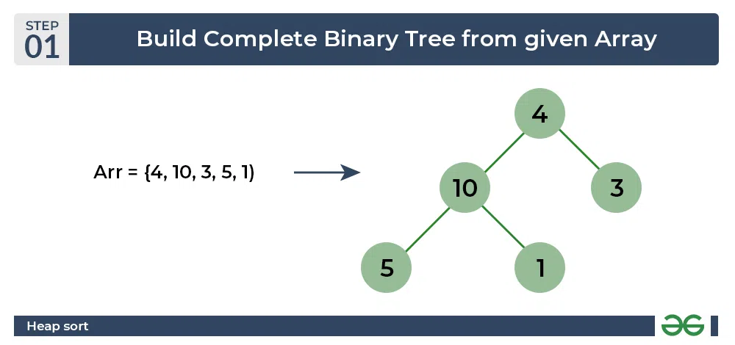
Heap Sort
Heap sort is a comparison-based sorting technique based on Binary Heap data structure. It is similar to the selection sort where we first find the minimum element and place the minimum element at the beginning. Repeat the same process for the remaining elements.

Slide 33
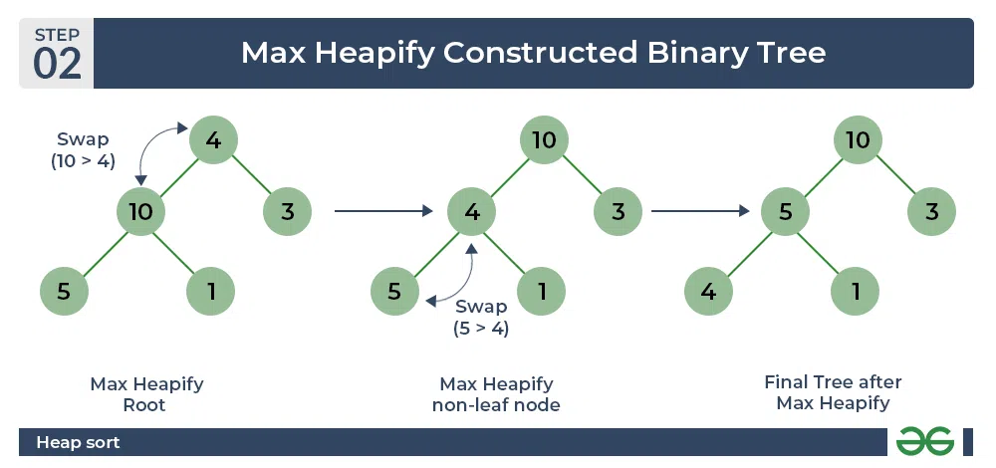
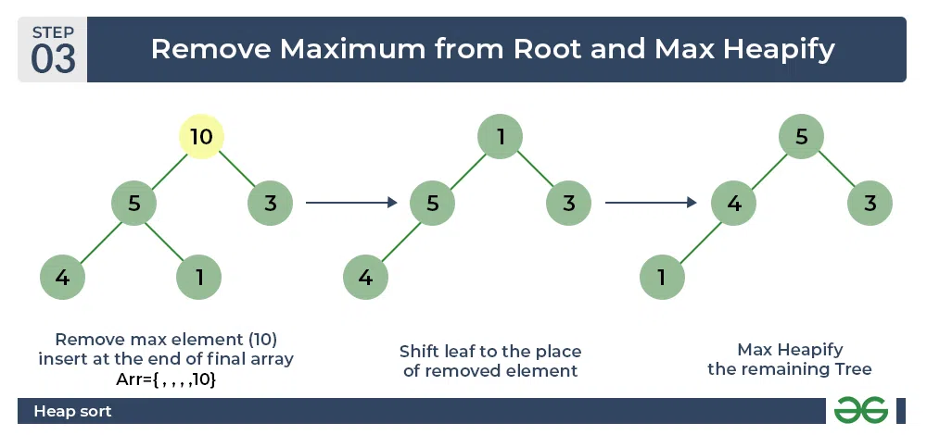
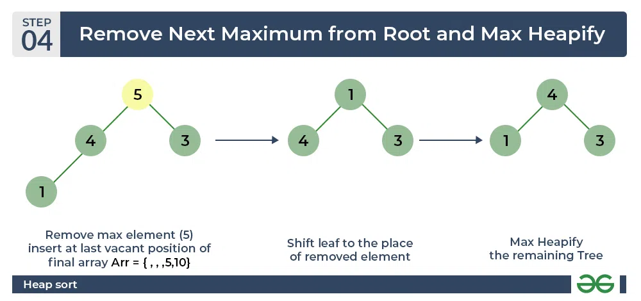
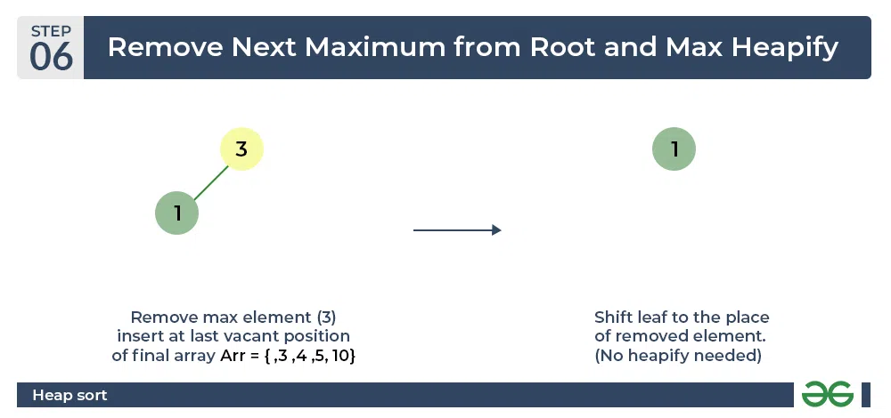
Heap Sort

Slide 34
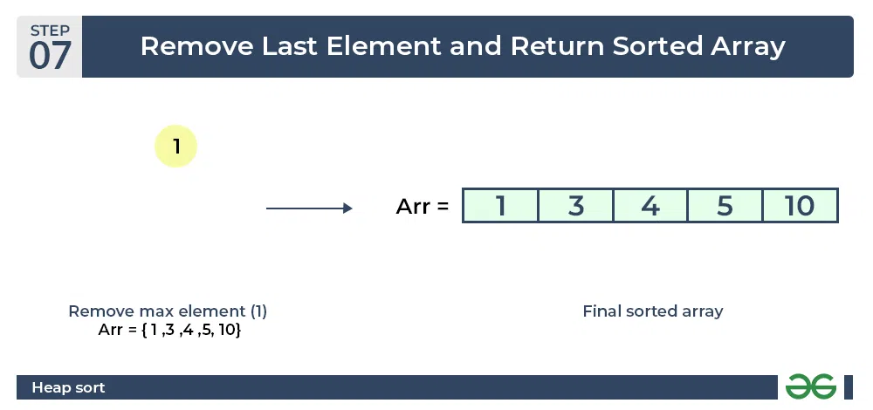
Heap Sort

Slide 35
Thank You!

